Slide 1
SECURITY SYSTEM FOR DNS USING CRYPTOGRAPHY

Slide 2
OBJECTIVE
To provide security by combining the concept of both the Digital Signature and Asymmetric (public key) cryptography by sending the Public key over the Network.

Slide 3
ADVANTAGE OF DNS
Humans prefer names to IP addresses
Prefer yahoo to 164.107.51.28
Simple Solution: Hosts.txt
Drawback: Not scalable
Solution: DNS (Adopted in 1983)

Slide 4
EXISTING SYSTEM
The existing system is manually maintained.
It uses RSA Algorithm for key generation.
Since it uses RSA Algorithm it is necessary to provide two Prime numbers to generate Key Pair which results in Mathematical and Brute force attack.
It sends the Private key through the Network.
Time consumption
Low reliability
DISADVANTAGES
Error prone
Less operational speed
Low speed communication

Slide 5
The Following function avoids the pitfalls of the existing system
Fast and efficient work
Ease of access to system
Manual Effort is reduced

Slide 6
PROPOSED SYSTEM
Taking the above prevailing system into consideration the best solution is using Pseudo Random Number Generator for generating Key Pair in a quick and more secured manner.
SHA-1 for producing We use MD5 (or) Message Digest and Compressing the message.
Signature is created using Private Key and Message Digest which is transmitted along with the Public Key.
The transfer of the packets from each System to System is shown using Graphical User Interface (GUI).

Slide 7
ADVANTAGES OF PROPOSED SYSTEM
They are not limited to 1024 bits like DSA
They can use hash longer than 160 bits.

Slide 8
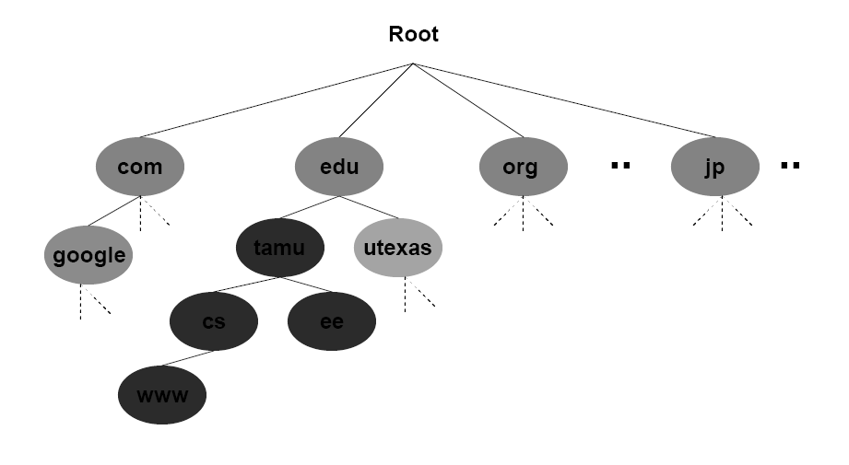
DNS Architecture

Slide 9
Overall Diagram
ENCRYPTION,
KEY GENERATION,
SIGNATURE GENERATION,
SIGNATURE VERIFICATION,
DECRYPTION
SENDER
ORIGINAL
ORIGINAL
RECEIVER
MESSAGE
MESSAGE

Slide 10
MODULES
Key Generation
Encryption and Decryption
Signature Creation
Signature Verification

Slide 11
MODULE DESCRIPTION
KEY GENERATION
Taking two prime numbers
Generating random numbers
Generating public and private keys
The key pair (public and private key) is generated using the Cryptography PRNG (Pseudo Random Number Generator) Algorithm.

Slide 12
SIGNATURE GENERATION
M
E
Enc Mes
D
M
Private key
Public key

Slide 13
Key Generation
Module Design
PRNG ALGORITHM
CALL THE METHOD IN
THE CODING
GENERATE TWO RANDOM NUMBERS
(PUBLIC AND PRIVATE KEY)
DISPLAY THE KEYS IN THE
BACK END
GENERATE SIGNATURE
AND SEND

Slide 14
IMPLEMENTATION
Authentication
Message Encryption using Message Digest Algorithm
Key Generation using PRNG Algorithm
Signature Generation
Verifying Signature and Decrypting

Slide 15
AUTHENTICATION
AUTHENTICATION
ENTER THE USER NAME AND
PASSWORD
VERIFY
TEXT FILE
LOGIN
SEND MESSAGE OR ATTACHMENT

Slide 16
MESSAGE ENCRYPTION
MESSAGE DIGEST ALGORITHM
READ CHARACTER BY
CHARACTER
CONVERT EACH CHARACTER
TO ASCII CODE
CONVERT THE ASCII CODE
TO HEX CODE
ENCRYPTED MESSAGE

Slide 17
KEY GENERATION
PRNG ALGORITHM
CALL THE METHOD IN
THE CODING
GENERATE TWO RANDOM NUMBERS
(PUBLIC AND PRIVATE KEY)
DISPLAY THE KEYS IN THE
BACK END
GENERATE SIGNATURE
AND SEND

Slide 18
SIGNATURE GENERATION
DSA ALGORITHM
Sender PRIVATE KEY + ENCRYPTED
TEXT FILE
GENERATE SIGNATURE
Global
PUBLIC KEY + SIGNATURE
SEND THROUGH THE
NETWORK

Slide 19
VERIFYING SIGNATURE AND DECRYPTING
DESTINATION
PUBLIC KEY ,SIGNATURE
FROM THE SENDER
GENERATE SIGNATURE USING
DSA ALGORITHM
VERIFY THE SIGNATURE
NO MATCH
DISCARD
IF MATCHES
DECRYPT THE MESSAGE
OR FILE
REPLY TO THE SOURCE

Slide 20
ATTACK ON ROOT SERVER
OCTOBER 23, 2002
DDOS on root servers
9 out of 13 servers were down
Slowdown after 8 or more servers are down
No noticeable slowdown observed by users

Slide 21
ATTACK ON MICROSOFT
22.5 hour outage of web sites
Series of attacks on Name servers, Jan 2001
Reasons – attack or misconfiguration?
Intermittent access to Microsoft.com, MSN.com
$200 million advertising campaign
Microsoft Web sites drew 54 million unique
visitors in December

Slide 22
THREATS TO DNS
IP Spoofing
Cache poisoning (DNS Spoofing)
Client flooding
Information leakage

Slide 23
DNS SECURITY EXTENSION
Idea: Add a digital signature to each Name
Information
– Signing with the zone’s private key
– Authenticating with the zone’s public key
Main issue
– Key genereation
– DNS as Public Key Infrastructure

Slide 24
CRYPTOGRAPHIC TECHNIQUE USED
No key (Digital Signature)
One key (Symmetric Key)
Two key (Asymmetric key)
SECURITY

Slide 25
SYSTEM REQUIREMENTS
HARDWARE REQUIREMENTS
PROCESSOR III AND ABOVE
20 GB HARD DISK
256 DDR RAM
SOFTWARE REQUIREMENTS
MICROSOFT.NET FRAMEWORK 1.1
INTERNET INFORMATION SERVER
BROWSER(I E OR NETSCAPE)

Slide 26
CONCLUSION:
The security threats for DNS was overcome by using public key validation and it was implemented and executed successfully

Slide 27
References
Computer Networks by Tanenbaum
Java 2: The Complete Reference, Fifth Edition (Paperback) by Herbert Schildt “.
Java Unleashed (Unleashed S.) by Michael Morrison.
Java 2 Bible by Justin Couch and Daniel H. Steinberg

